Slide 1

Job hunting during Covid April 2020-June 2020
Welcome to the Alpha of the hiring process

Slide 2
Assumptions
Everyone means well
Everyone acts with the best information they have

Slide 3
Market
April
Zombie Postings
Canceled Offers
May
Preparatory Hiring
Bargain shoppers
June
Some Hiring
Rates are half

Slide 4
Step 1. Recruiters
Furlough
Forced Vacation
New Processes

Slide 5
Every crappy event you encounter they will encounter 10x as often

Slide 6
Step 2. Phone screens
These stayed the same
You did not stay the same
Your interviewer did not stay the same

Slide 7
You
May have unlearned to interact business casually with strangers
Listen to some podcasts / comedy to warm up
Lean into the strange
What if all we remember from 2020 in 2030 is the murder hornets?

Slide 8

They are in a boat like you
Probably not the same one

Slide 9
Step 3. Interviews
Alpha
Etiquette
Tools

Slide 10
Alpha
You may be the first one they are trying to hire remotely

Slide 11
Etiquette
camera / no camera
dress
eye contact
distracted participants
chat vs voice
environment
late

Slide 12
TOOLS
Online meeting tools
Shared coding interview tools
Whiteboarding tools

Slide 13
Online meeting tools
Test Audio & video
Test changing Audio & Video
Share Screen
Un-Share Screen
Share App
Un-Share App
Clean your desktop / apps

Slide 14
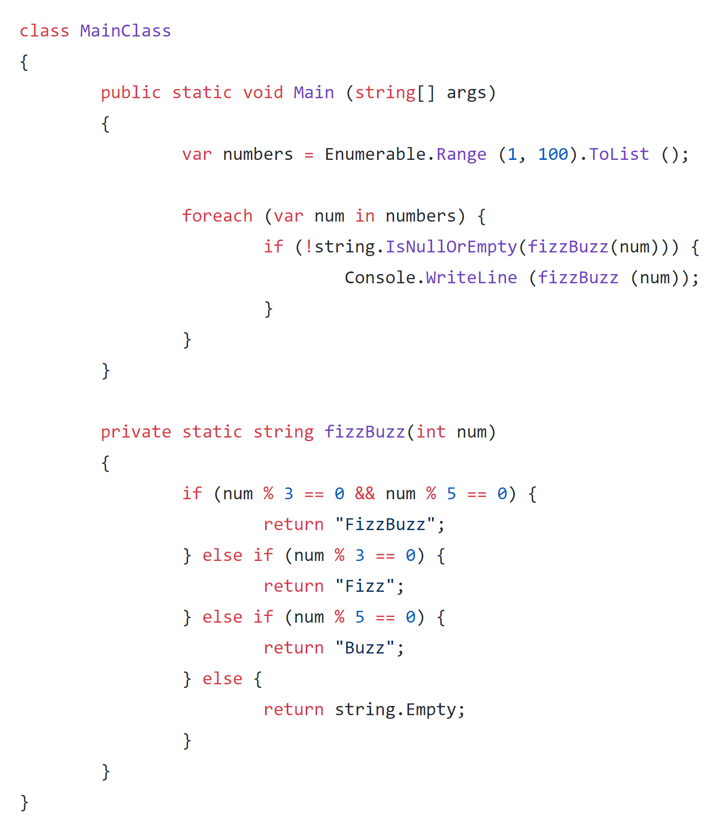
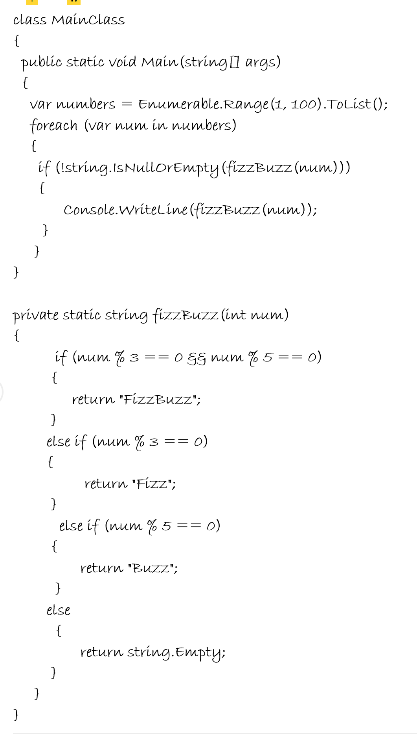
Shared Coding interview

Slide 15
Have a Backup ready
Set up your dev tools with an mpty project ready to go

Slide 16
White Board tools
Try them
Cheat
Have a Local Backup

Slide 17
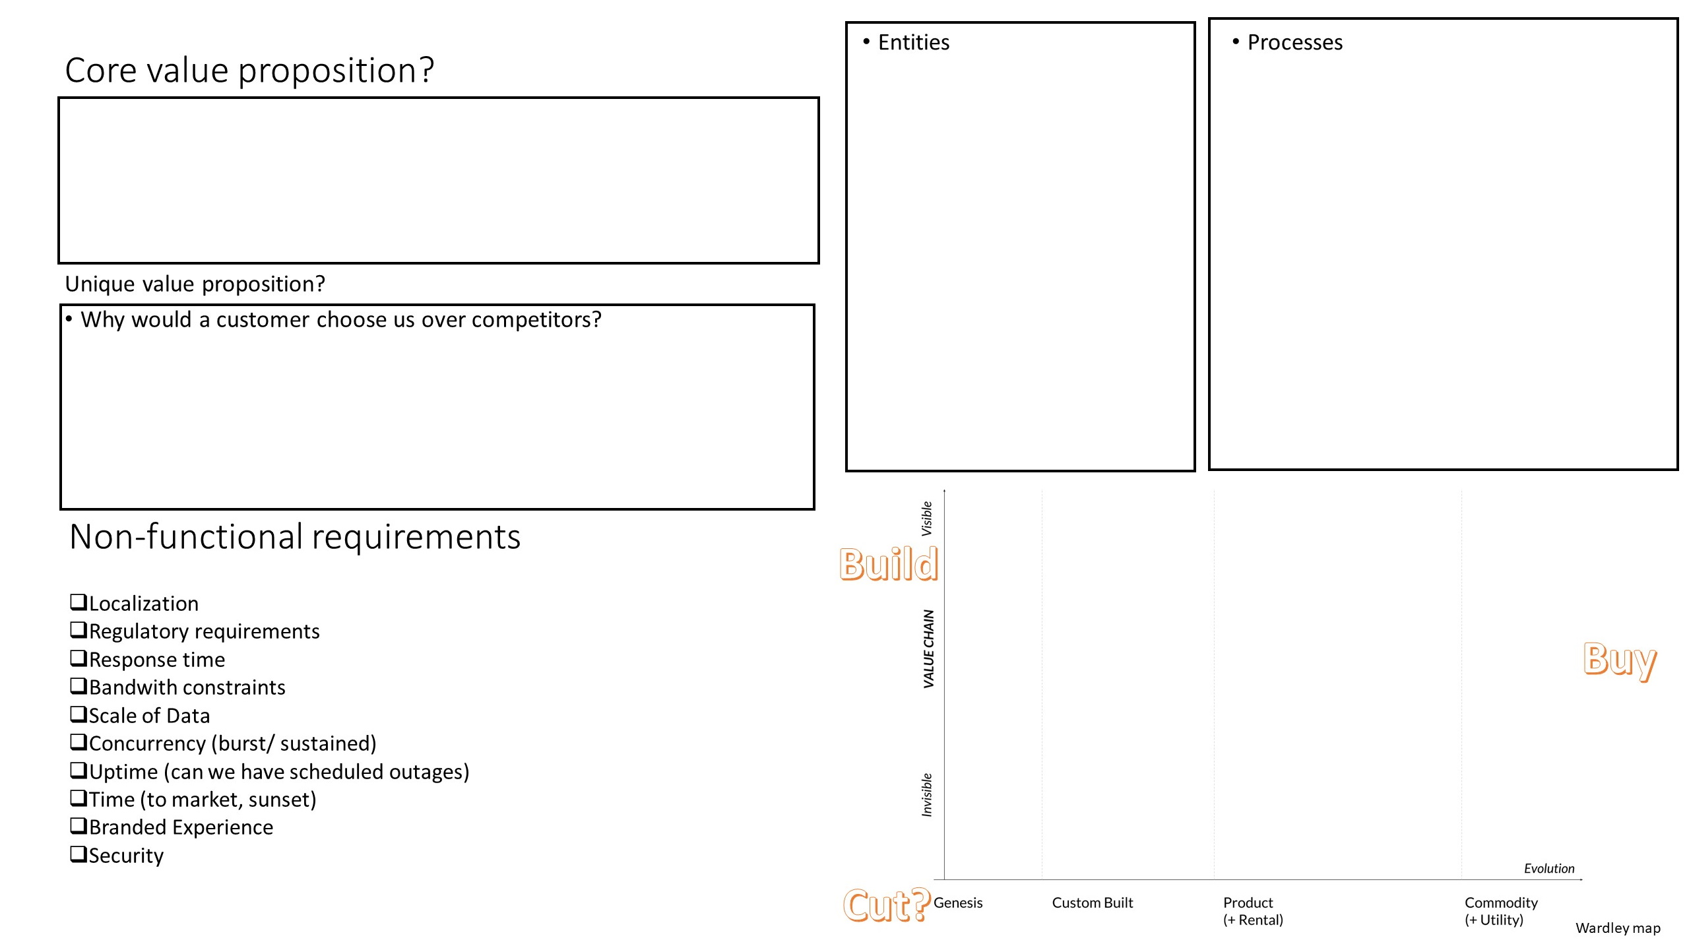

Slide 18
Retro your interviews
Keep improving your setup

Slide 19
Good luck
Resources @ https://github.com/BasHamer/Interview-Resources

